Slide 1
Top-down influence for motor behavior
Elizabeth Mamantov • mamantov@umich.edu

Slide 2
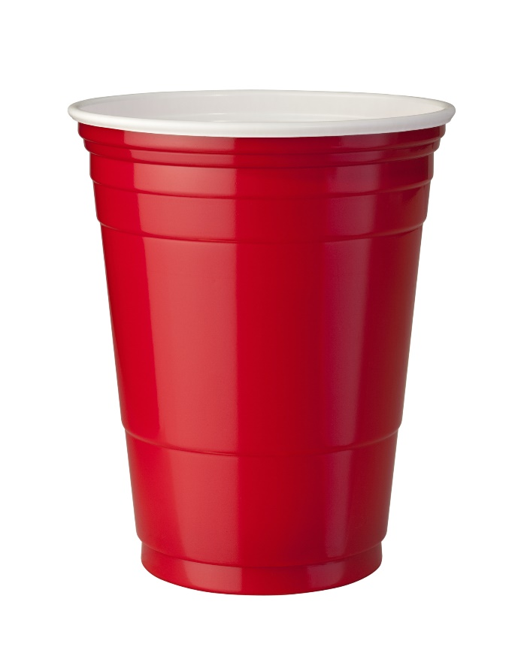
Object Knowledge is valuable for manipulation
Empty
Water
Juice

Slide 3
Motion Planner + Soar
Search- or Sampling-Based Planner
Soar
Low-level mathematical processing
Plan grasp
Search through joint space
Inverse kinematics
Detailed control
High-level problem solving
Choose an object to pick up
Decide where to place it
Retain object knowledge
Task learning
Dictate
Negotiate

Slide 4
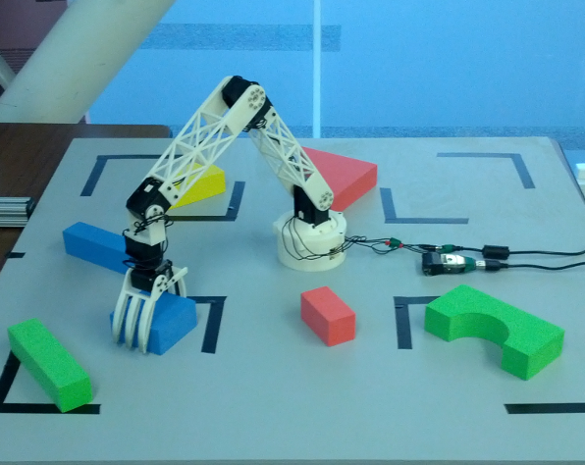
Search-based planning for Manipulation
Rosie tabletop arm
Search-based planning algorithm [Cohen et al, 2014]
Processing time vs solution quality tradeoff because search algorithm is anytime
Processing time vs search granularity tradeoff via control of search lattice graph
Typically <1s planning time for 5DOF arm

Slide 5
Interaction between Levels
Search-Based Planner
Soar
Can provide to Soar:
Existence of plan
Obstacle clearances
Cost or length of plan
Can provide to the planner:
Granularity of search
Limit on processing time
Regions to avoid or move through slowly
When to give up

Slide 6
Ongoing Work: Example
Soar decides to pick up the cup and requests a coarse-grained motion plan to assess feasibility.
Planner performs search over sparse lattice and finds a solution.
Soar uses knowledge of the cup to set a caution region around it.
Planner updates plan in that region.
Improved plan can be smoothed and executed.
Water

Slide 7
Questions/Comments
Cohen, Benjamin, Sachin Chitta, and Maxim Likhachev. "Single-and dual-arm motion planning with heuristic search." The International Journal of Robotics Research 33.2 (2014): 305-320.

